Slide 1





Ear Electronic Device for Tinnitus Frequency Finding and Adjusting to Provide Relief to Tinnitus Suffering Patient

Slide 2

INTRODUCTION:
Embarking on the challenges of tinnitus, affecting 10% of individuals, our revolutionary Ear Pod device steps in.
Beyond the audible perception, tinnitus intertwines with issues like anxiety and reduced quality of life
With risk factors ranging from aging to drug therapies, our Ear Pod offers a proactive approach, acknowledging that while a cure is rare, it empowers users to navigate tinnitus, avoiding ineffective treatments and substantial costs.
In the realm of psychosocial care, our Ear Pod focuses on identifying triggers and imparting essential coping skills, ushering a new era for those living with persistent tinnitus

Slide 3
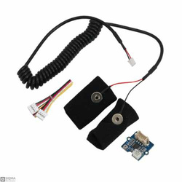
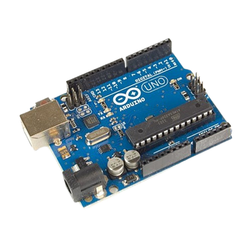


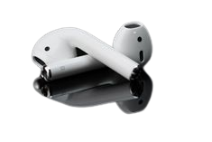
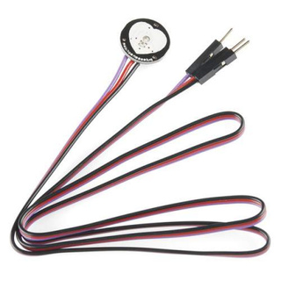
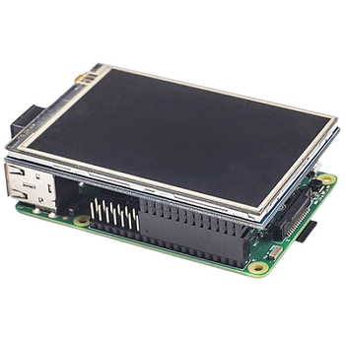
MOBILE APP
GSR SENSOR
ARDUINO UNO
FIREBASE CLOUD STORAGE
MACHINE
LEARNING TECHNIQUES
PULSE SENSOR
RASPBERRY PI
WITH LCD DISPLAY

Slide 4


TECHNICAL STACK:
IOT
DEVICE
ANDROID
QT
FRAMEWORK
FLUTTER
CLOUD
MACHINE LEARNING

Slide 5

TINNITUS ASSESSMENT:
Advanced signal analysis algorithms assess and identify the precise frequency spectrum of tinnitus.
enables personalized insights for effective management within the app.
FEATURES
FEATURES
TINNITUS PROGRESSION CLASSIFIER:
Utilizing machine learning classification, the app dynamically categorizes and offers tailored information on different tinnitus stages, facilitating informed user guidance.
TINNITUS ASSESSMENT
TINNITUS PROGRESSION
CLASSIFIER
AUDITORY DISTRACTION MODULE:
Seamless audio streaming with an adaptive content management system, providing users with personalized distraction through curated playlists and ambient sounds.
AUDITORY DISTRACTION
MODULE
REVERSE FREQUENCY
REVERSE FREQUENCY:
Real-time inverse frequency modulation is employed, potentially counteracting perceived tinnitus noise by generating an audio signal with an inverted frequency spectrum.

Slide 6


FREQUENCY PREDICTION FOR EACH USER:
NORMAL
OR
ABNORMAL
PULSE READINGS
DESCISION TREE 1
DESCISION TREE 2
DESCISION TREE n
VOTING AVERAGE
PREDICTION

Slide 7
SHOW STOPPER:
Limitations in Sensor Accuracy: Reliance on Predictive Measurements:
While our sensor readings provide valuable insights, it's essential to acknowledge a significant limitation – the data obtained is inherently approximate rather than precise.
Challenges in Treatment Planning: Consideration of Previous Medical Conditions and Tinnitus Assessment
Dealing with people who already have health problems, like high blood pressure, gets tricky. Our method of checking for tinnitus using pulse readings adds another layer of complexity.

Slide 8
PROJECT COST:
PRODUCT COST:
RASPBERRY PI 4
8000
PCB design and fabrication
1500
LCD
1500
LCD
600
ARDUINO
350
Pulse Sensor
100
PULSE SENSOR
150
Galvanic Sensor
500
GALVANIC SENSOR
750
TOTAL
10700
TOTAL
2700

